Slide 1
Hematologists: mini medical school lesson

Slide 2
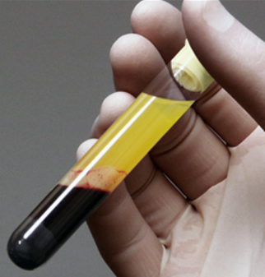
Centrifuged blood

Slide 3
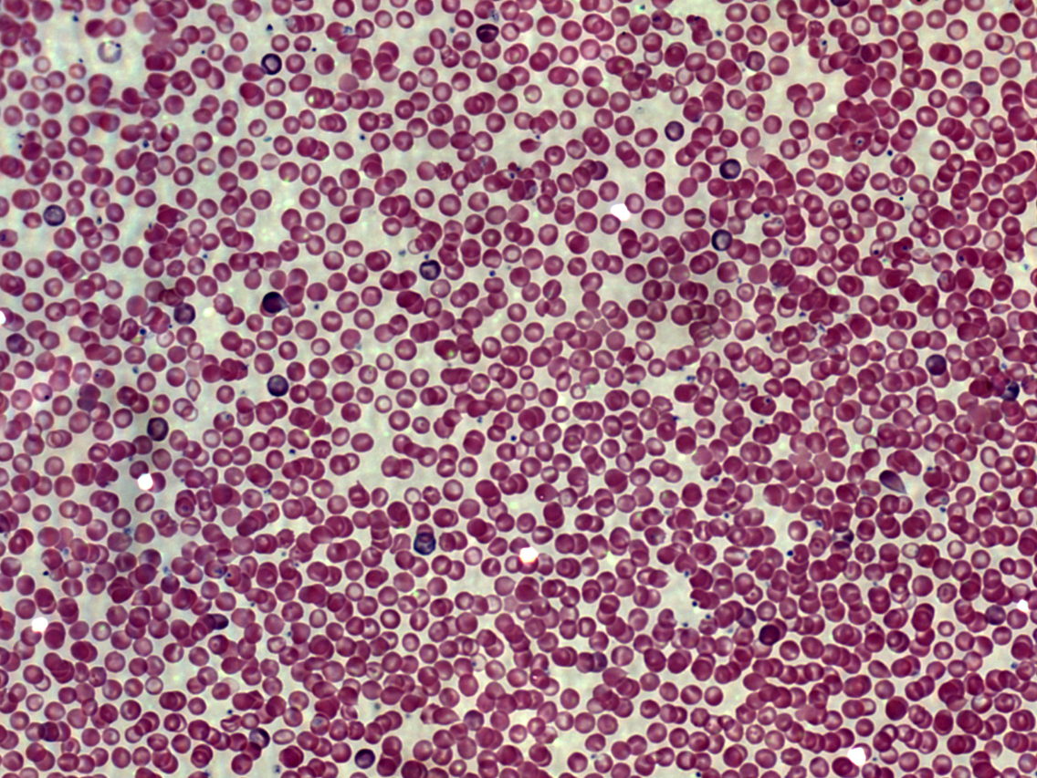
Normal cbc (complete blood count)

Slide 4
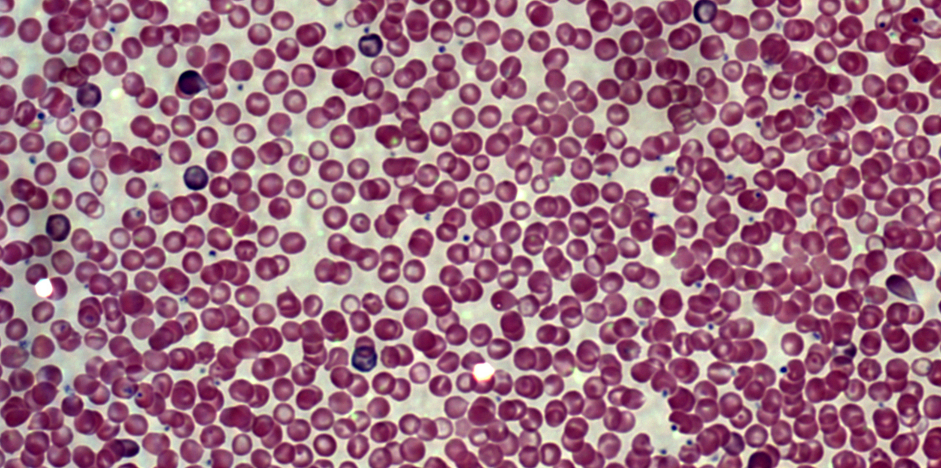
Normal cbc (complete blood count) magnified

Slide 5
Normal cbc lab results
CBC | Patient Value | Normal Range
WBCs | 5.5 K/uL | 4.5-11 K/uL
RBCs | 4.5 million/uL | 3.5-5.5 million/uL
Hb | 15.6 g/dL | 13 - 18 g/dL
HCT | 48% | 45% to 52%
PLTs | 200 K/uL | 150-400 K/uL

Slide 6
Patient bt
Patient BT is a one-year-old, previously well, Asian-American boy. He was referred to the General Pediatric service because of tiredness (lethargy) and pale skin (pallor). There was no history of blood loss. BT is still breast fed several times per day and takes infant formula with iron. He eats rice, vegetables, and meats. His mother is 19 years old and has no other children. BT's father is 22 years old and is frequently away from home working as a fisherman. Notable observations on physical exam included a palpable mass in the left upper quadrant suggestive of an enlarged spleen (splenomegaly) and distinct pallor.

Slide 7
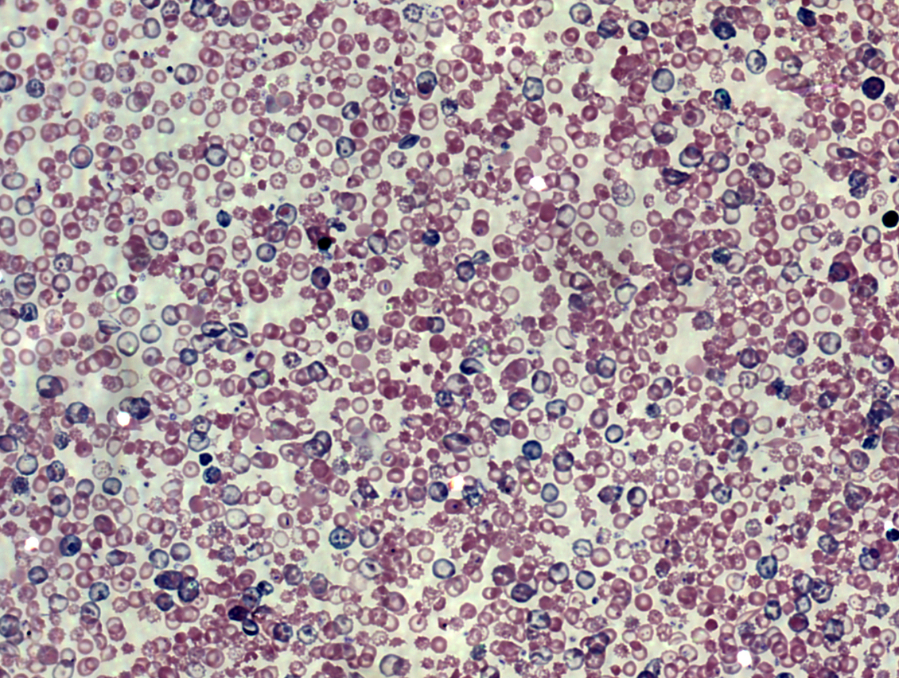
Patient bt blood smear

Slide 8
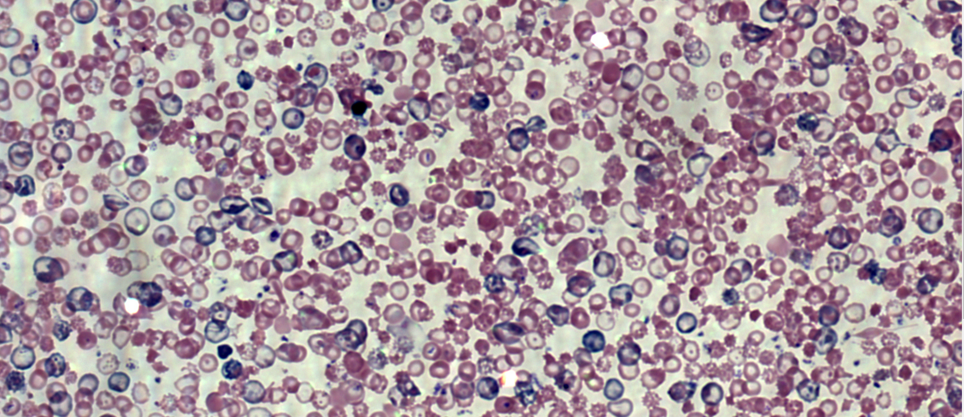
Patient bt blood smear (magnified)

Slide 9
Patient bt cbc lab results
CBC | Patient Value | Normal Range
WBCs | 7.5 K/uL | 4.5-11 K/uL
RBCs | 3.5 million/uL | 3.5-5.5 million/uL
Hb | 5.6 g/dL | 13 - 18 g/dL
HCT | 36% | 45% to 52%
PLTs | 200 K/uL | 150-400 K/uL

Slide 10
Patient AL
Patient AL is a sixty six year-old, previously well, Caucasian man. He presented to his primary care physician complaining of weightloss, weakness, lightheadedness, fatigue, and fever without chills. There was no history of blood loss.

Slide 11
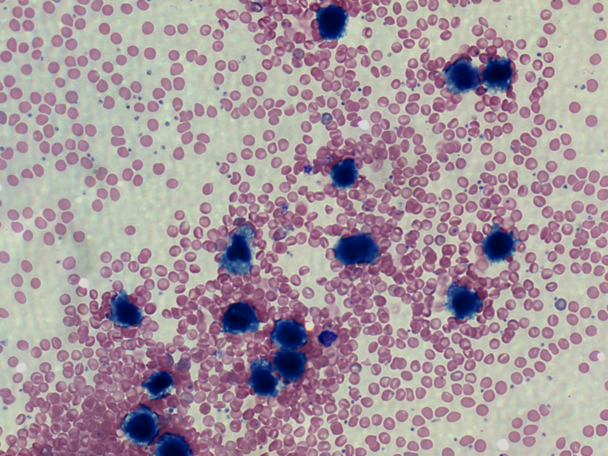
Patient AL blood smear

Slide 12
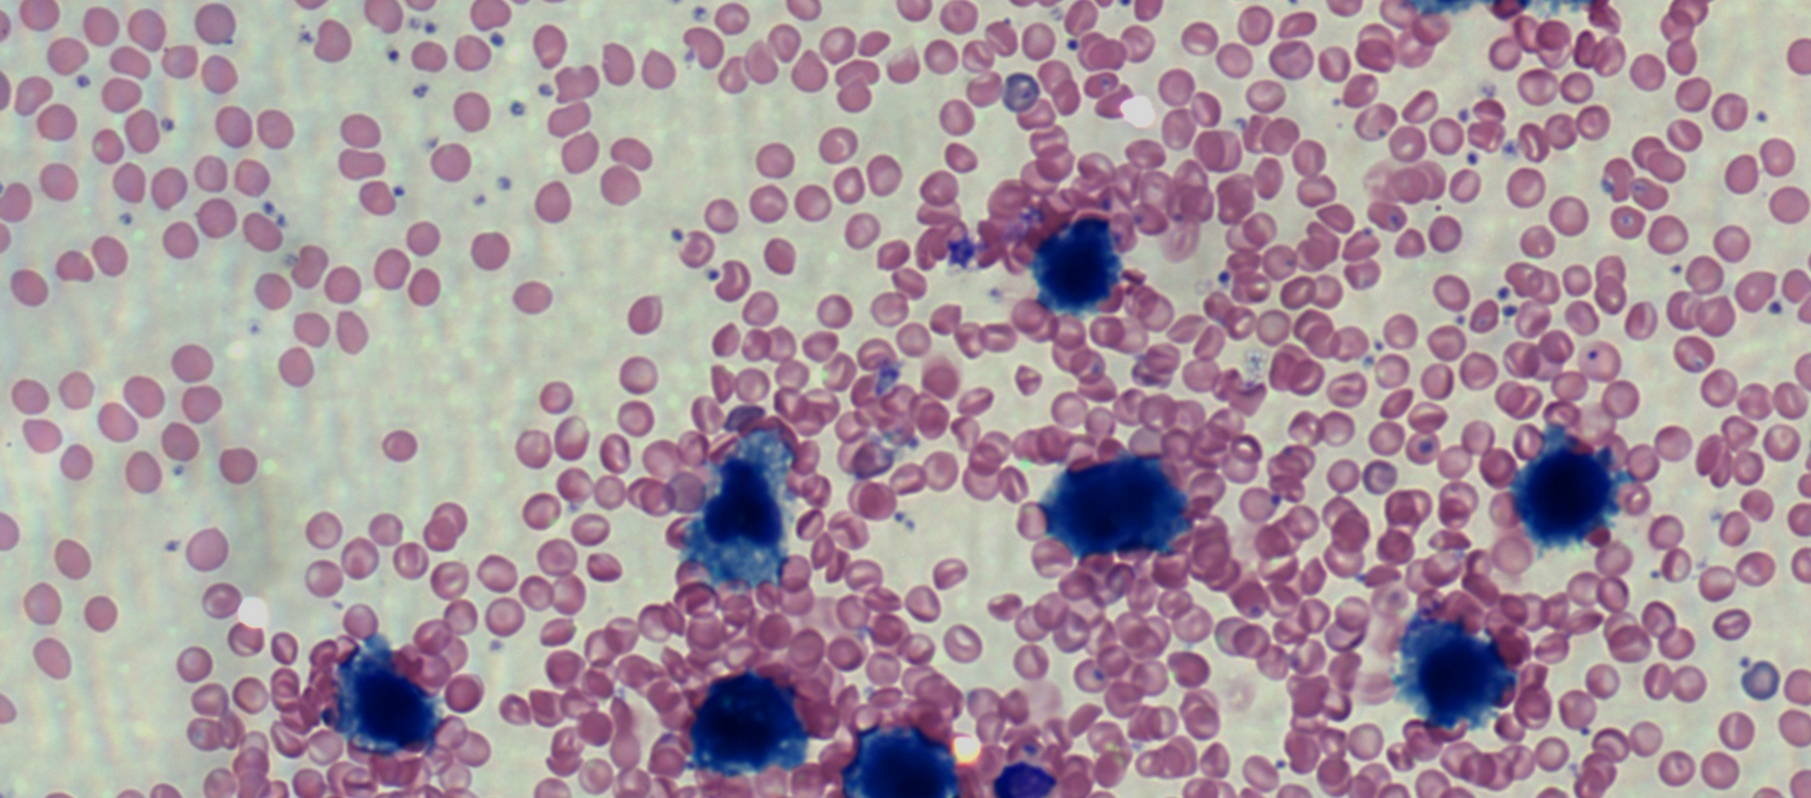
Patient AL Blood Smear magnified

Slide 13
Patient AL cbc lab results
CBC | Patient Value | Normal Range
WBCs | 29 K/uL | 4.5-11 K/uL
RBCs | 4.5 million/uL | 3.5-5.5 million/uL
Hb | 10 g/dL | 13 - 18 g/dL
HCT | 41% | 45% to 52%
PLTs | 150 K/uL | 150-400 K/uL

